Slide 1
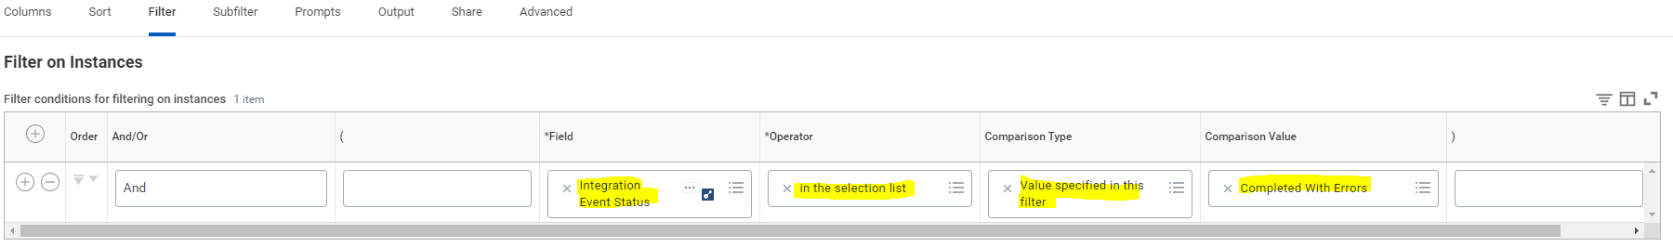
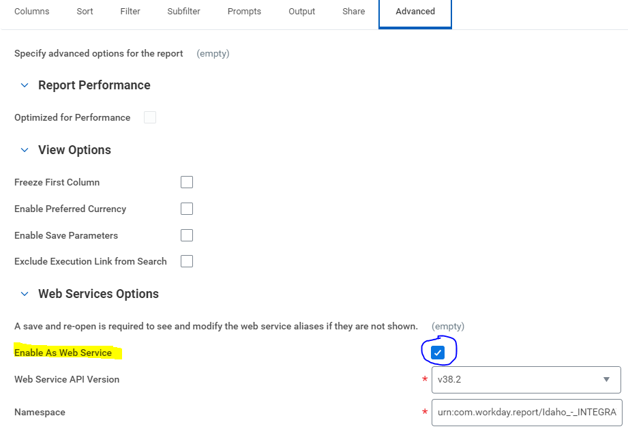
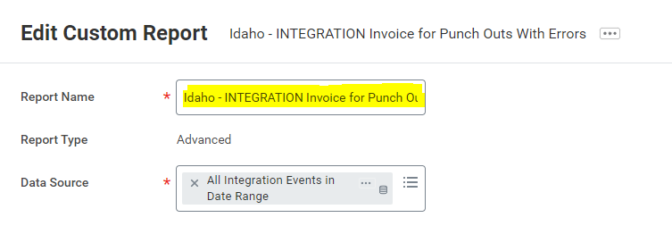
I have a report called "Idaho - Invoice Integration Events for Punch Outs with Errors" which is a copy of a report you guys did a few weeks ago. Can I get you to put a filter on this one on the Integration Event Status being "Completed With Errors". Also, can you see if you can bring in the attachments from the Data Source? Can you also rename it Idaho - INTEGRATION Invoice for Punch Outs With Errors ? Make it web enabled. I am going to try using this report in an integration.
Step 1 (Can I get you to put a filter on this one on the Integration Event Status being "Completed With Errors“)
Step 2 (Also, can you see if you can bring in the attachments from the Data Source?)
Step 4 (Make it web enabled)
Step 3 (Can you also rename it Idaho - INTEGRATION Invoice for Punch Outs With Errors)

